Slide 1
Do good with Good Busy Tools for the business case about the benefits and impact of employee volunteering
Version 2: January 2023
purpose

Slide 2
purpose
Make your own business case
It’s great that you want to start with employee volunteering and that you and your colleagues want to make a greater social impact. Enclosed you will find the ingredients to help you make your business case.
A business case shows whether a project contributes positively to the business objectives at an acceptable risk. In other words, whether the return on investment is higher than the investment you put in.
Good Busy supports you in creating support and making choices when setting up impactful employee volunteering programmes by supplying studies, facts and figures, and other practical tools.
The information in this business case can be freely used by anyone who wants to bring employee volunteering to a higher level.
If you use or publish information from this business case, please remember to cite sources.
And if you like to add something, please let us know via goodbusy@nov.nl. By doing so, you will also help other companies to be ‘Good Busy’.
Good luck and, above all, have fun creating a greater social impact!
Team Good Busy

Slide 3
Contents
Introduction: Make your own purpose case
Experiences of other companies
What do you need to get started?
Definitions
The many facets of volunteering (types of volunteering)
Facts and figures
Making an impact
Impact on society
Impact on employees
Impact on the business
Volunteering as part of the HR policy
Balance between purpose and profit
Opportunities of SDGs
Good Busy helps

Slide 4
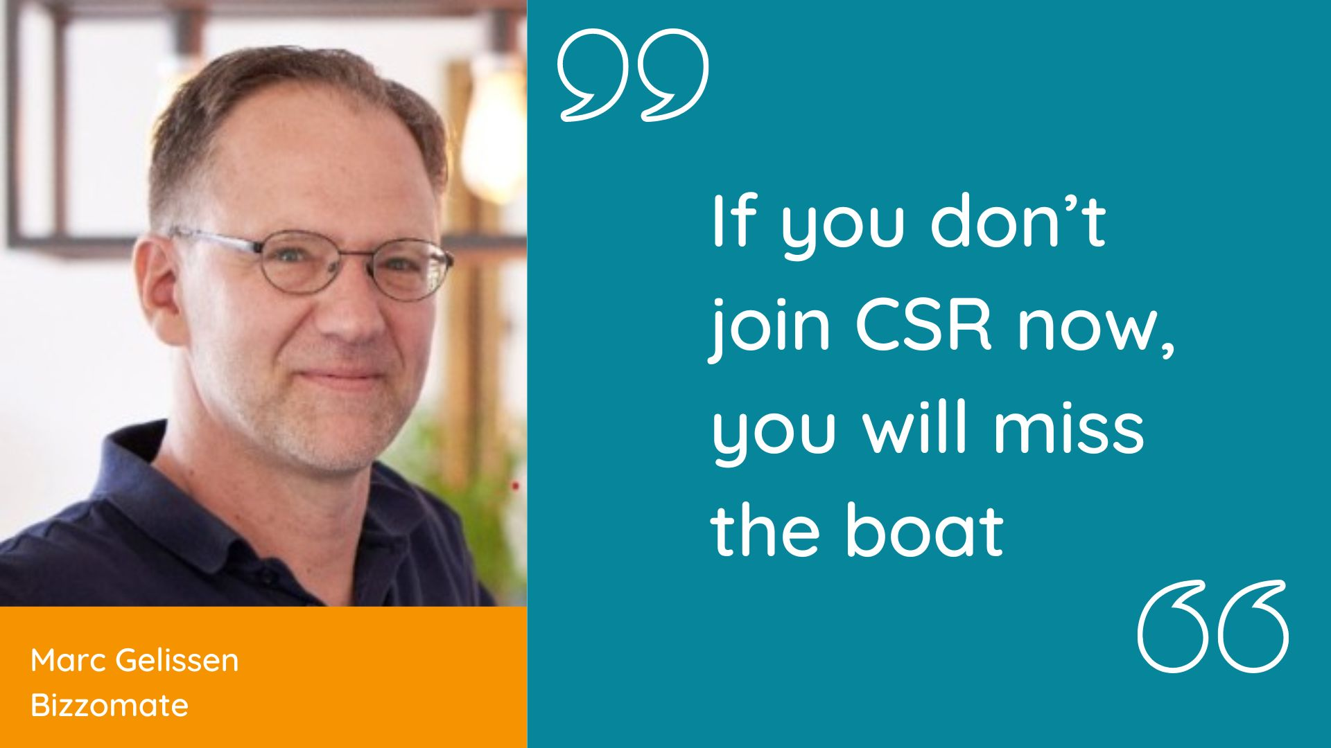
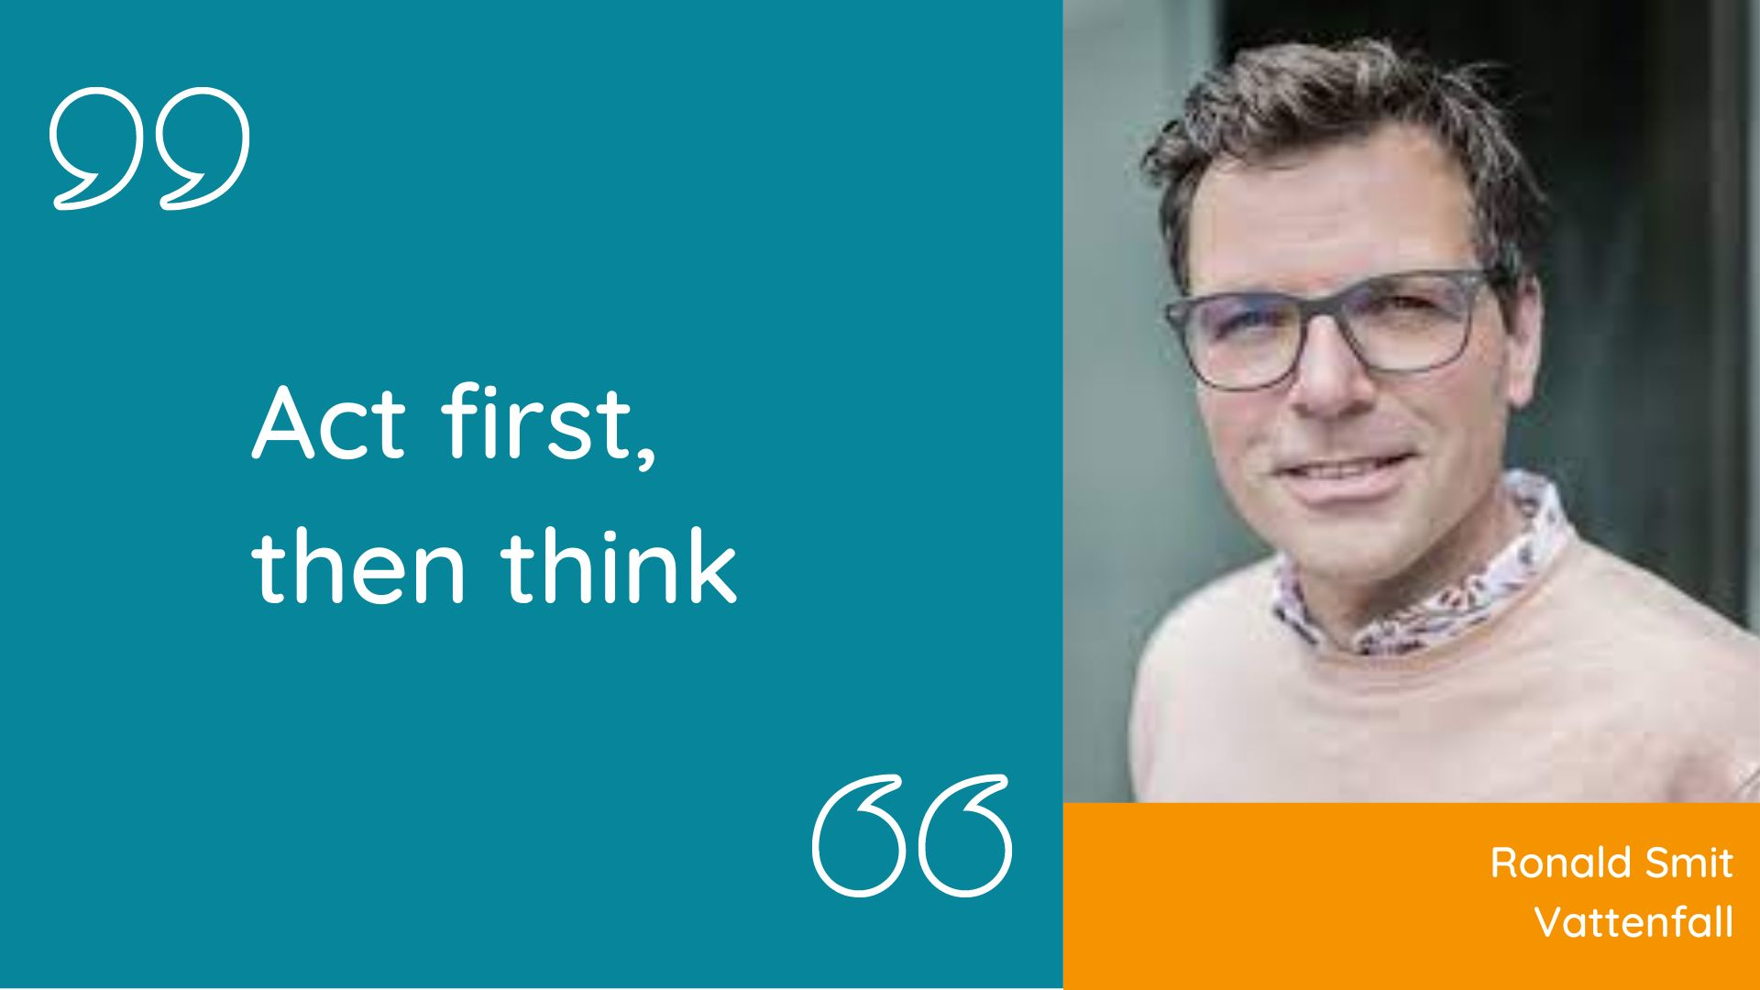
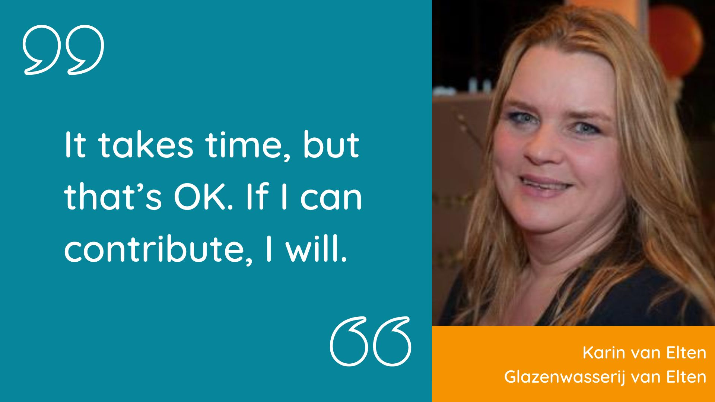
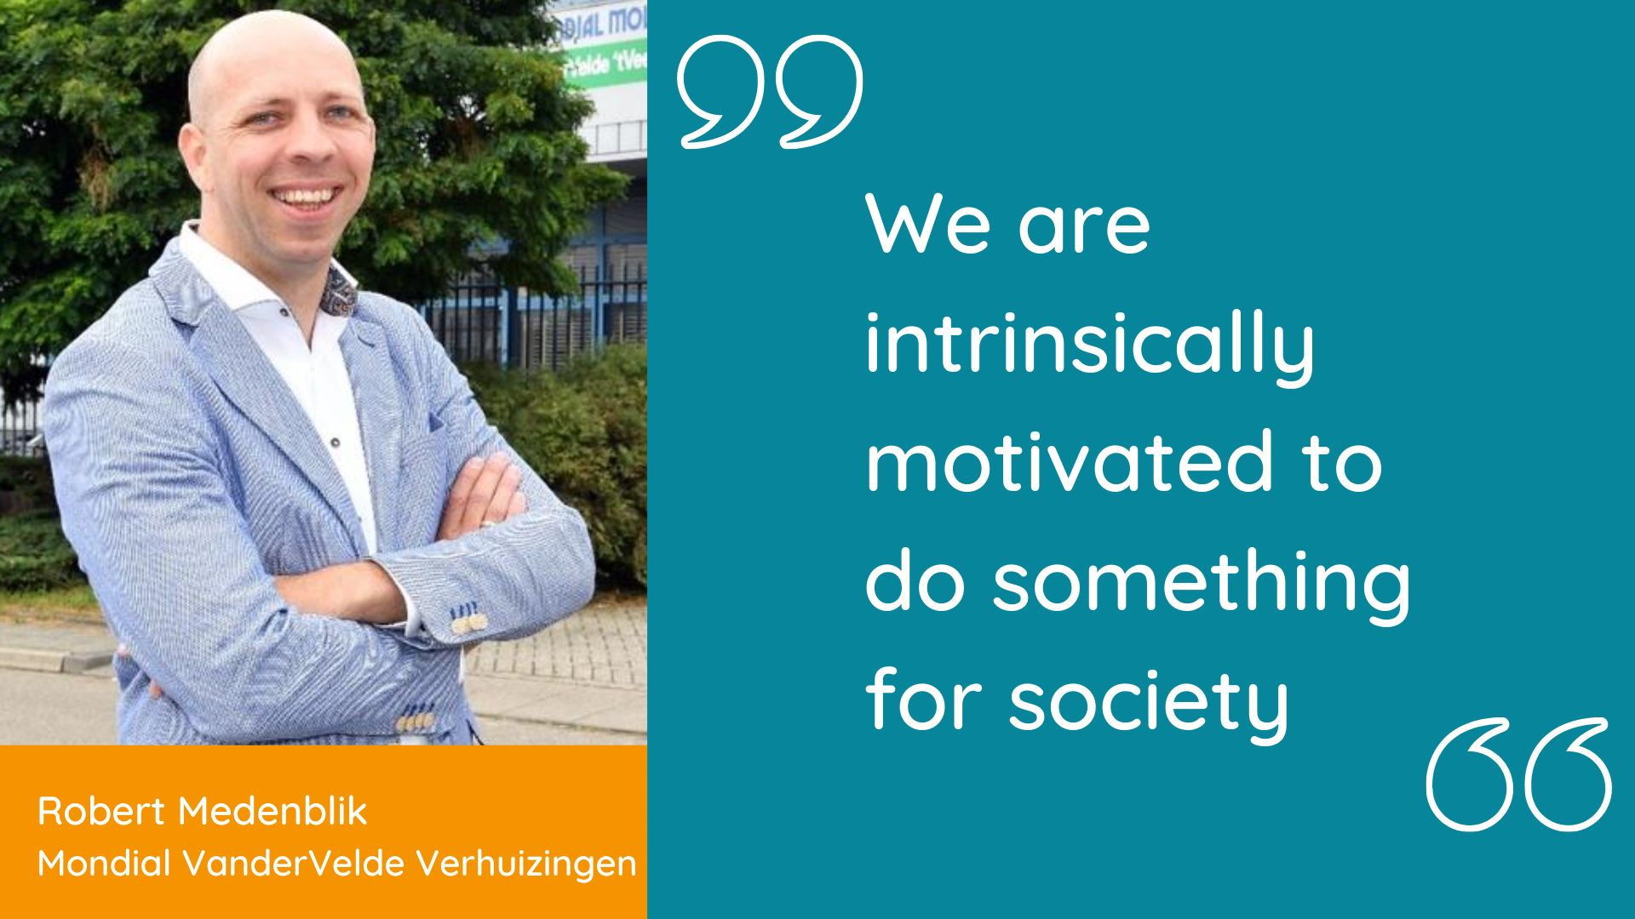
Experiences of other companies
Notes:
Ik zou hier de verwijzing naar het artikel weglaten, omdat de interviews immers in het Nederlands zijn.
1. If you don’t join CSR now, you will miss the boat
2. Act first, then think
3. It takes time, but that’s OK. If I can contribute, I will.
4. We are intrinsically motivated to do something for society

Slide 5
What do you need to get started?
To start an employee volunteering programme you need the following basic ingredients:
An important first step is, of course, intrinsic motivation
Management commitment
Consider recruiting staff with an affinity for coordination and communication
And specify an initial budget for partnerships and projects
In the toolkit on social impact you will find the 5 principles for employee volunteering programmes with an impact.
Notes:
Principle 1: Balance between company strategy and employee passion
Principle 2: Shape effective partnerships
Principle 3: Recognize the many positive facets of volunteering
Principle 4: Volunteering as an essential part of HR
Principle 5: Embed volunteering policy in your organisational culture

Slide 6
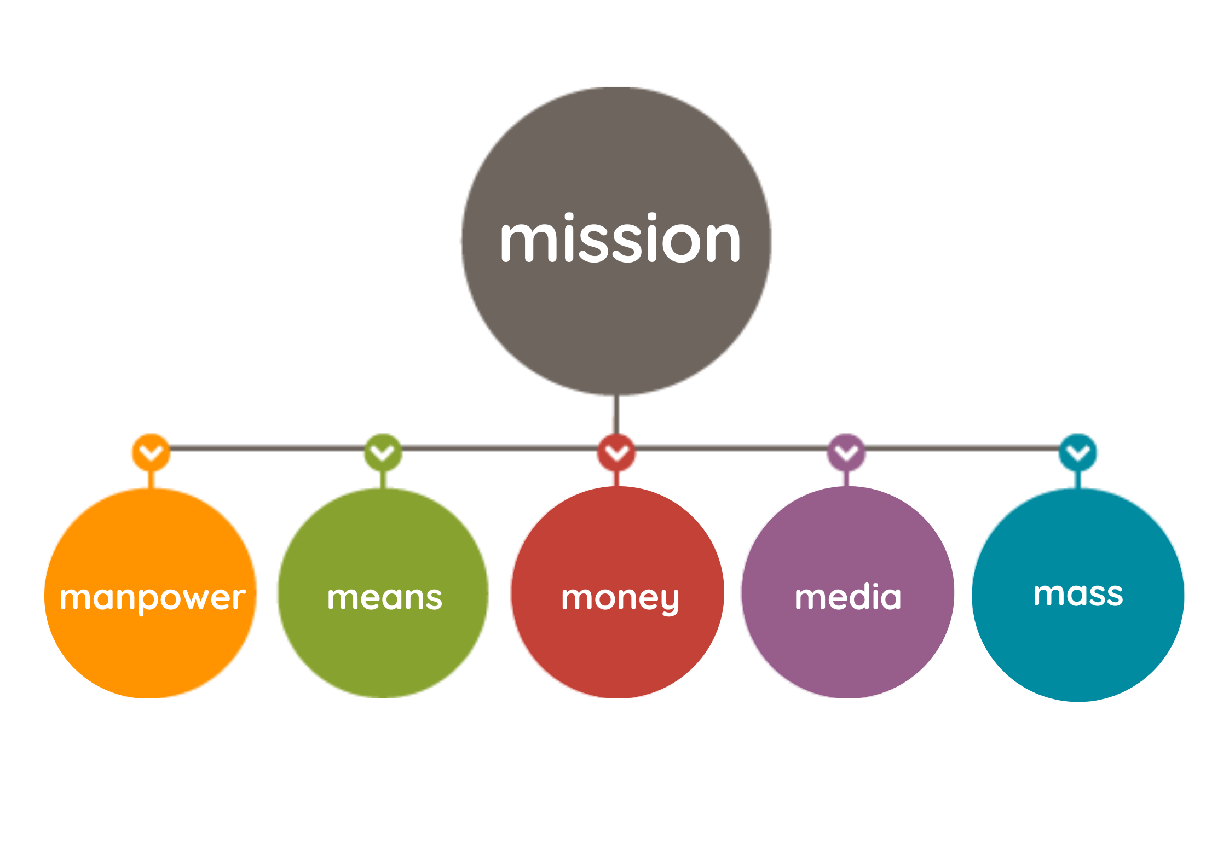
Definitions
What is employee volunteering?
Voluntary contributions made by your employees is also known as employee volunteering or corporate volunteering.
Employees of a company make time and knowledge available to social enterprises, non-profit organisations or charities.
By contributing to one-off activities or making long-term connections they can strengthen together - local - communities and create social impact.
What is CCI?
Employee volunteering is a form of Corporate Community Involvement (CCI)
There are various ways to shape your CCI as a company. You can contribute to society by sharing resources such as manpower, means, money and expertise.
This philosophy is based on the 5M model.
Source: Good Busy Toolkit for social impact
Notes:
5M model:
Mission:
Manpower
Means
Money
Media
Mass

Slide 7
The many facets of volunteering
Are you a hands-on volunteering type who likes to do a social activity, perform a simple job or work in nature? Or do you prefer to share your skills and use your expertise to strengthen non-profit organisations and help them reach their goals and target groups? Both ways are possible with volunteering. The diagram below lists several examples in which an employee can support an organisation.
Needs social organisation | Support of a goal/target group | Strengthen organisations | Strategic development
Offer of a company | Hands-on volunteering Social activity with a target group Simple job activity/small project activity Working in nature Support paths Buddy, coach, mentor, etc. | Skill-based volunteering Pro bono expertise, amongst others in the field of: marketing & communication strategy & policy legal matters IT finance HR | Board activities Strategic advice
Source: Good Busy Toolkit on social impact

Slide 8
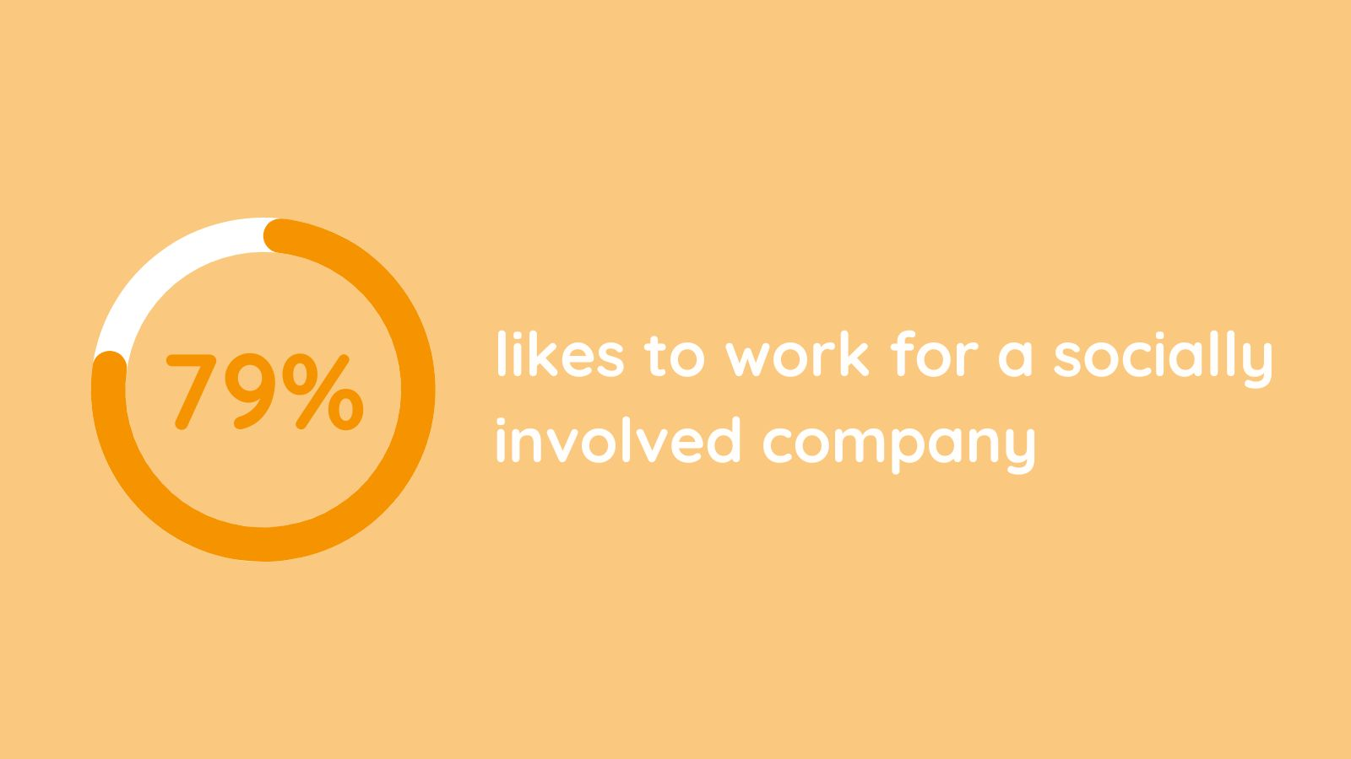
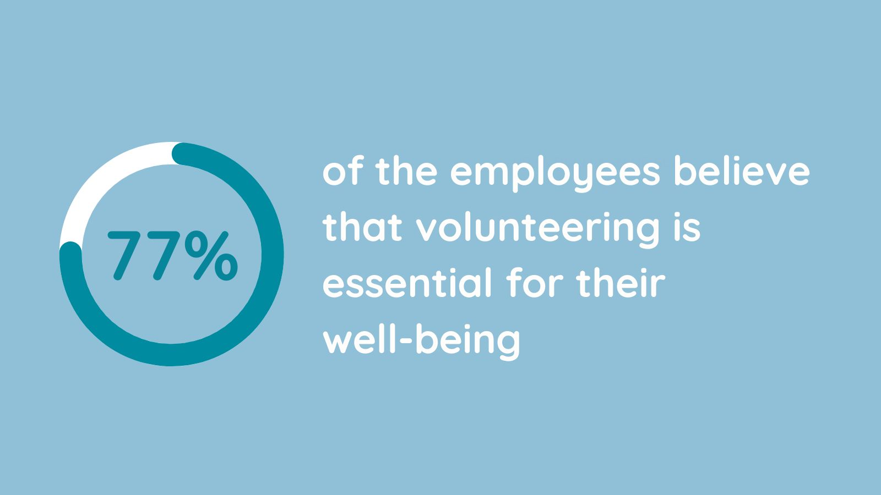
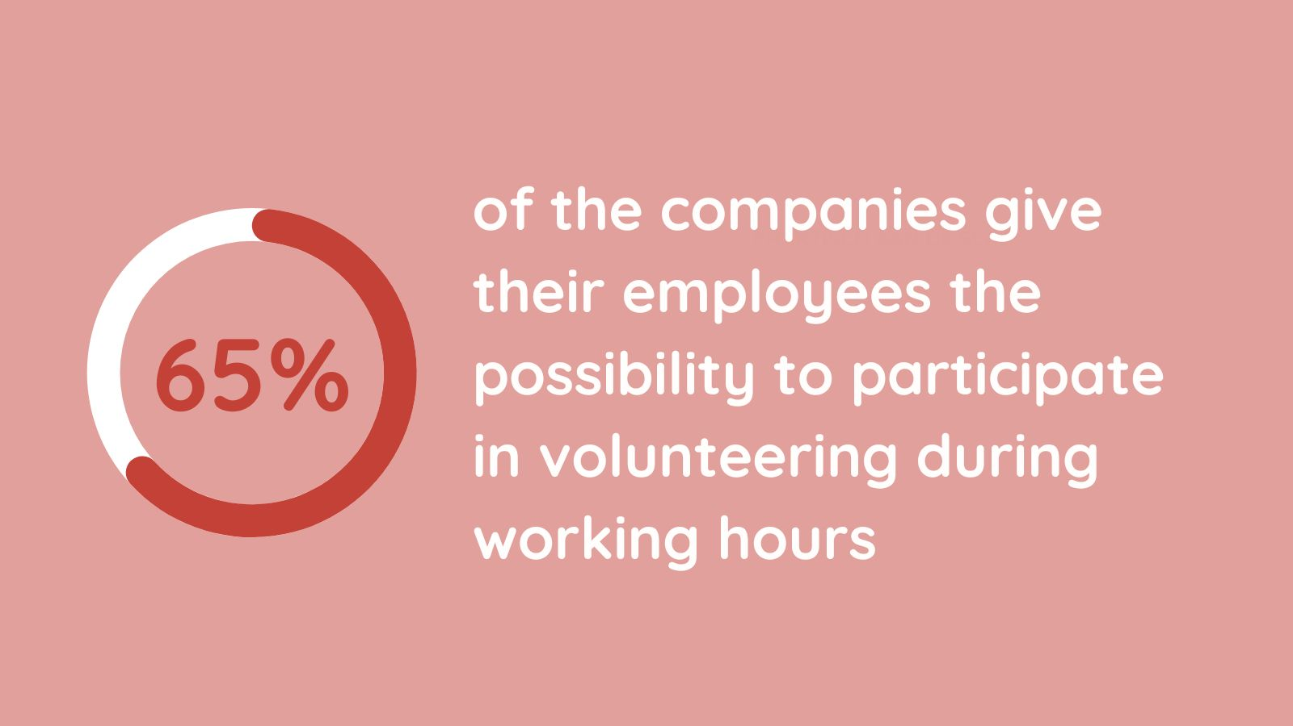
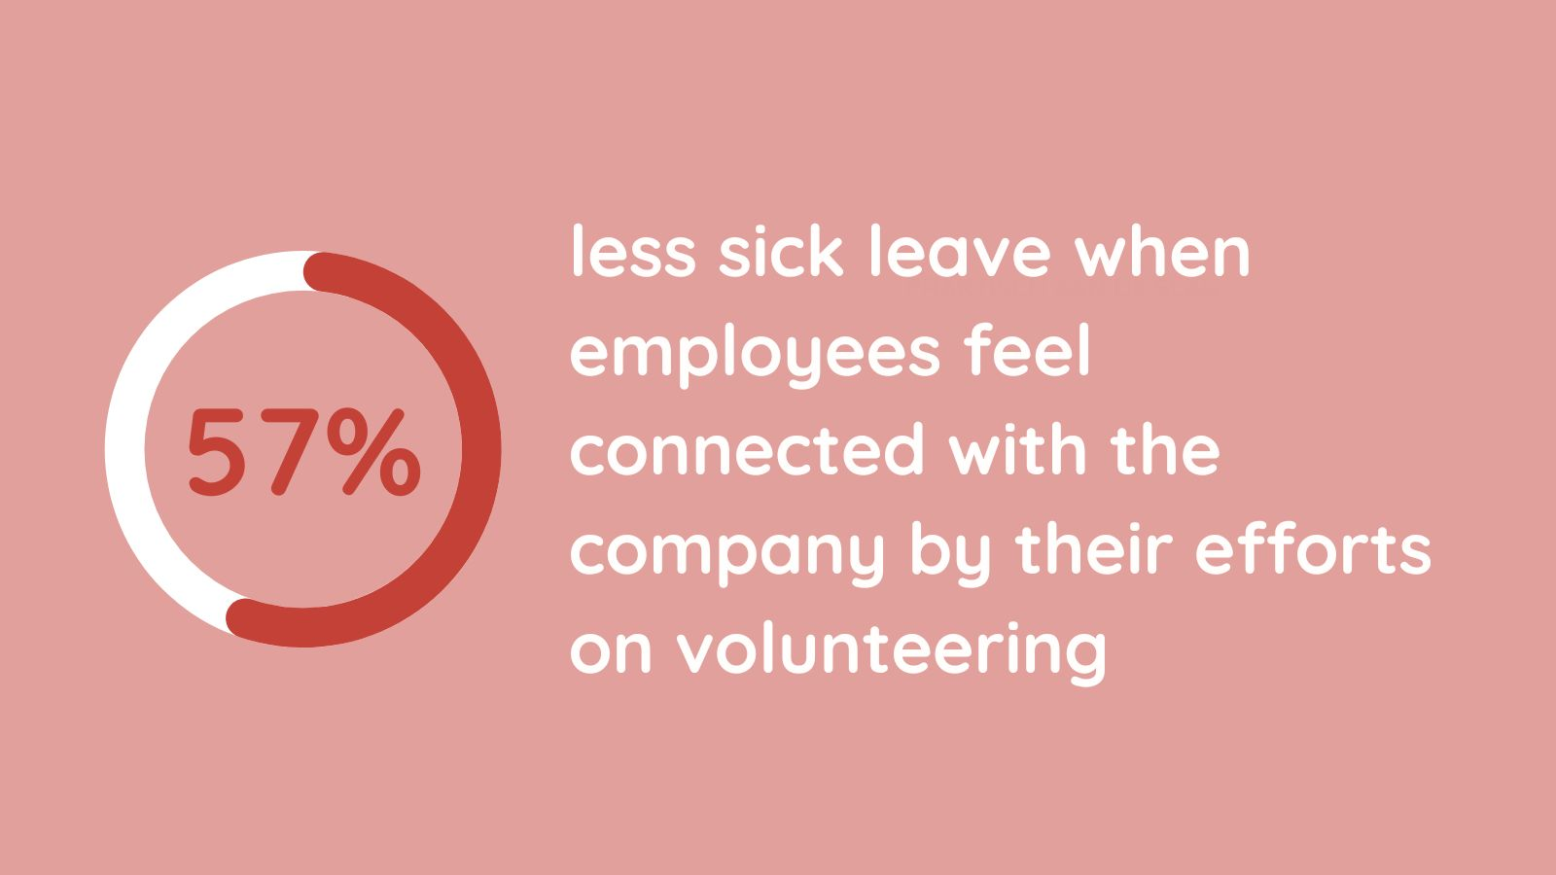
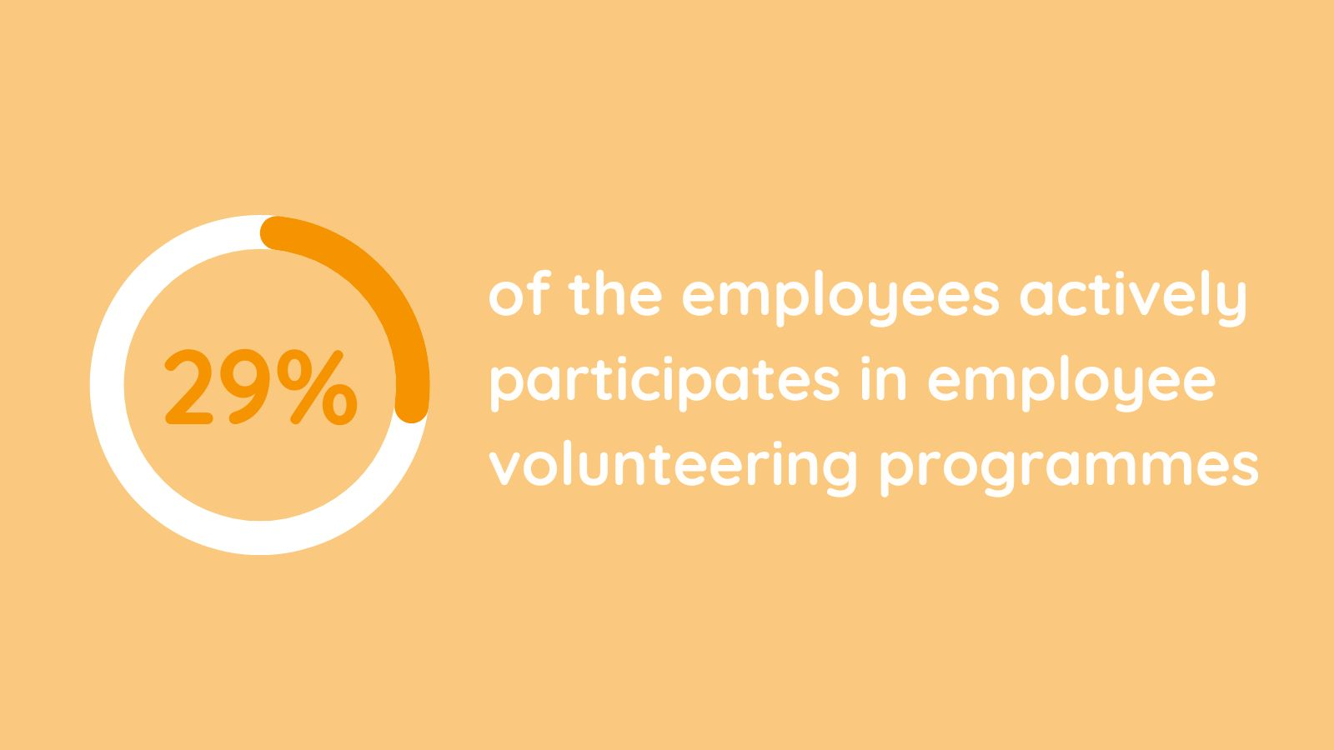
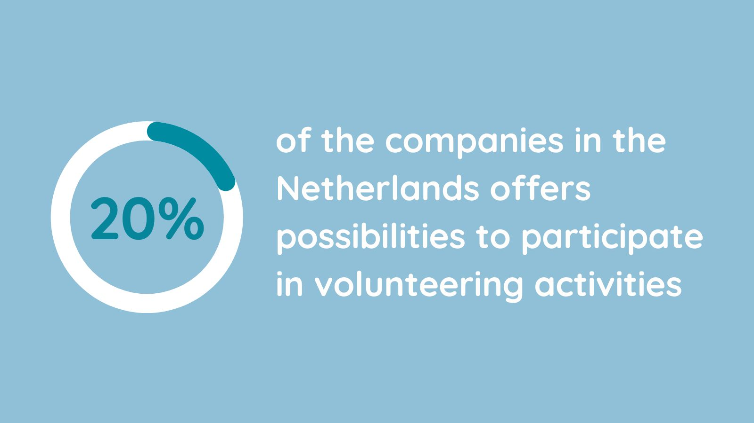
Facts and figures
Source: Samen voor Eindhoven
Source: Deloitte
Source: Geven in Nederland 2020
Source: Doing good is good for you
Source: CECP infographic 2020
Source: Geven in Nederland 2022
Bron: CECP infographic 2020
Notes:
79% likes to work for a socially involved company
77% of the employees believe that volunteering is essential for their well-being
65% of the companies give their employees the possibility to participate in volunteering during working hours
57% less turnover when employees feel connected with the company by their efforts on volunteering
29% of the employees actively participates in employee volunteering programmes
20% of the companies in the Netherlands offers possibilities to participate in volunteering activities

Slide 9
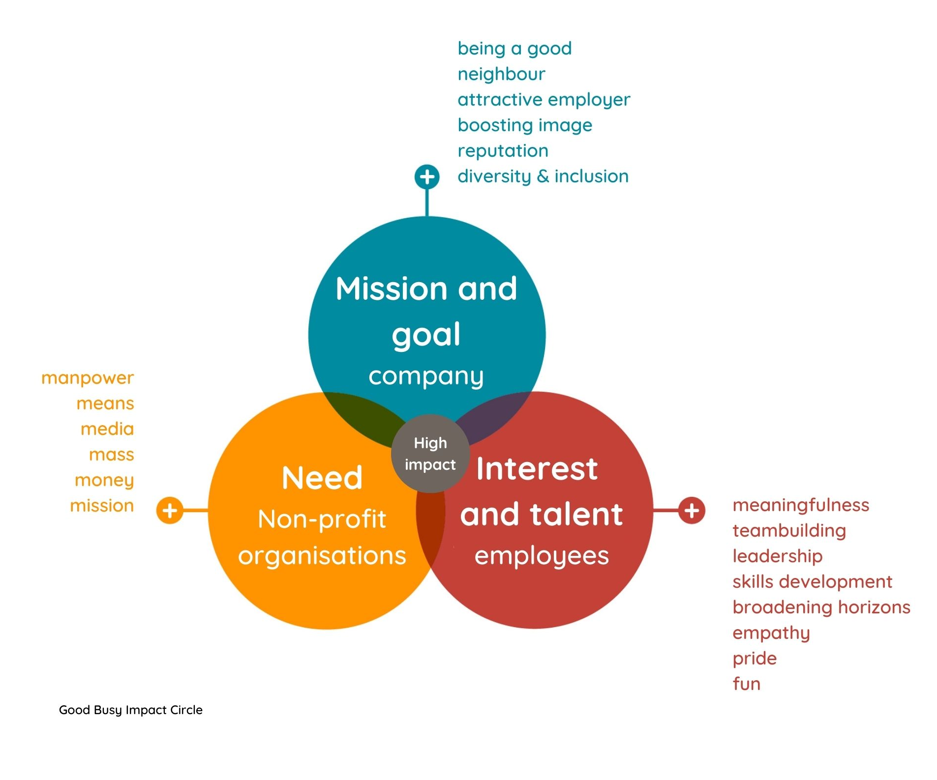
Making an impact
A company and a non-profit organisation can both benefit from a partnership and make a huge impact by working together.
The Good Busy impact circle visualises where the interests of parties meet and at that point the impact is the highest.
Notes:
Good Busy Impact circle
Oranje cirkel: Blauwe cirkel: Bruine cirkel:
Need Mission and goal Interest and talent
Non-profit organisations company employees
Oranje tekstgedeelte: Blauwe tekstgedeelte: Bruine tekstgedeelte:
Manpower Being a good neighbour meaningfulness
Means Attractive employer teambuilding
Media Boosting image leadership
Mass Reputation skills development
Money Diversity & Inclusion broadening horizons
Mission empathy
pride
fun

Slide 10
Impact on society
Your company takes responsibility and contributes to solving societal issues by being truly involved with the community.
Volunteering connects different target groups in society that might not normally meet, thus contributing to a diverse and inclusive way of thinking.
61% of the businesses in the Netherlands already actively contribute to society by sponsorships and/or donations. However, many social organisations are also looking for expertise and practical support, and this is where volunteers and businesses can make a substantial contribution.

Slide 11
Impact on employees
84% of employees gain more insight in and have a better understanding of the target group and its social problems by volunteering.
This leads to a broader understanding of people who are struggling and/or having social problems. It also gives a sense of purpose and meaning.
77% of employees say that company-supported volunteer activities are essential to their well-being and vitality.
Employees also develop (soft) skills through volunteering.

Slide 12
Impact on the business
It boosts your competitiveness and reputation as a socially committed company.
79% of the employees seek employers with a purpose or meaning.
It strengthens your position as an attractive employer, especially in this tight labour market.
It results in 57% less turnover if employees feel connected by the efforts a company makes in the field of volunteering.

Slide 13
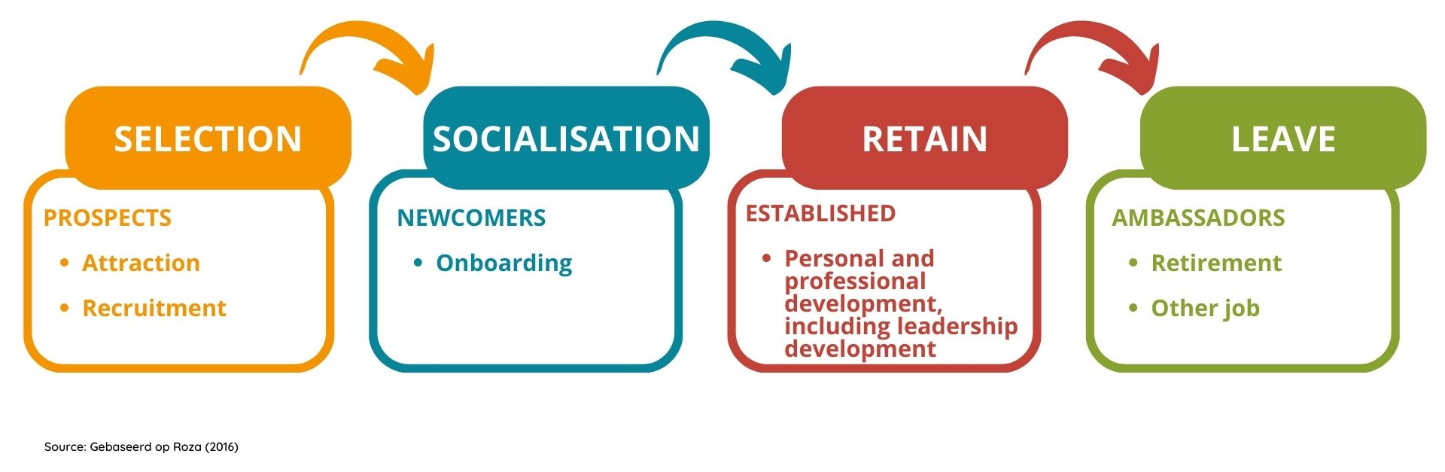
Volunteering as part of the HR journey
Employee volunteering contributes to attract, develop and retain employees. It is also a perfect tool to meet HR goals during the employee journey.
Notes:
Oranje: Blauw: Bruin: Groen:
SELECTION SOCIALISATION RETAIN LEAVE
PROSPECTS NEWCOMERS ESTABLISHED AMBASSADORS
Attraction Onboarding Personal and professional Retirement
Recruitment development, including Other job
leadership development

Slide 14
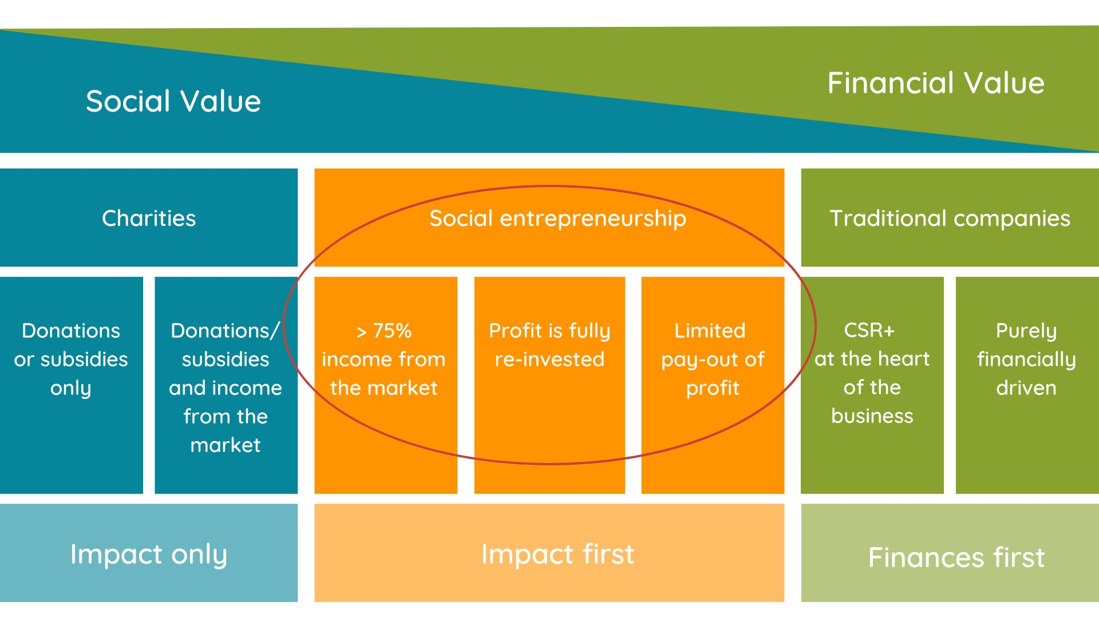
Balance between purpose and profit
Bron: Social Enterprise
Notes:
Zie apart Word-document

Slide 15
Opportunities of SDGs
When setting your goals, you can make use of the Sustainable Development Goals / SDGs

Slide 16
Good Busy helps
Visit www.goodbusy.nu
On our website you can find several toolkits and stories of entrepreneurs
Subscribe to the Good Busy newsletter
Follow us on LinkedIn
Read our 'snackables’ about studies, tips and tricks, etc.
Visit the Help & Advice page on our website
Have a look in the Good Busy library

Slide 17
www.goodbusy.nu
goodbusy@nov.nl
Notes:
For socially committed companies that do good in society

